Slide 1

Unit Line Inspector Measurement Guide
<Bako2120>
Audio R&D Lab.
2021. 05. 27
1

Slide 2
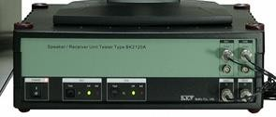
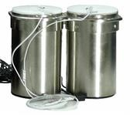

▣ Unit Line Inspector Measurement Guide
※ System Components
Item | Description
 | Type BK2120A Speaker & Receiver Test Unit DAQ Module DIO Board ICP Amplifier Power Amplifier
 | Coupler (Cabinet) Close Type, each for Left & Right (Built-in Microphone Sensor & Cable)
 | Type BS1123 Test Program BK1090 Sound Card COM1 → RS-232C 17” LCD-Monitor
Cables & Accessories | Power Cable RS232 Cable Stereo Audio Cables (55-jack to BNC) BNC to Clip

Slide 3
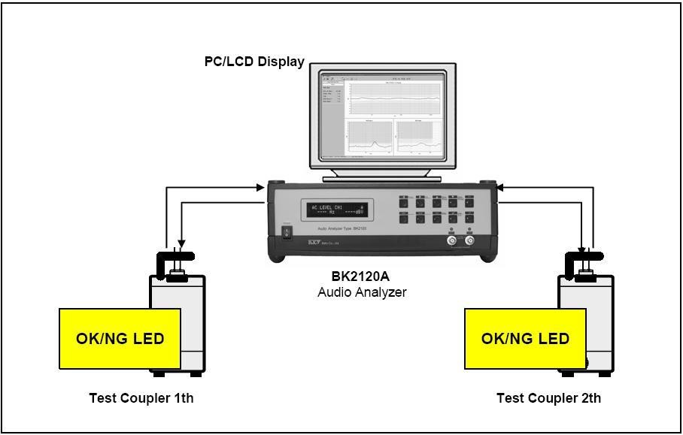






▣ Unit Line Inspector Measurement Guide
※ Measurement Environment
Unit
Test Coupler
Microphone
To BK2120 Input

Slide 4
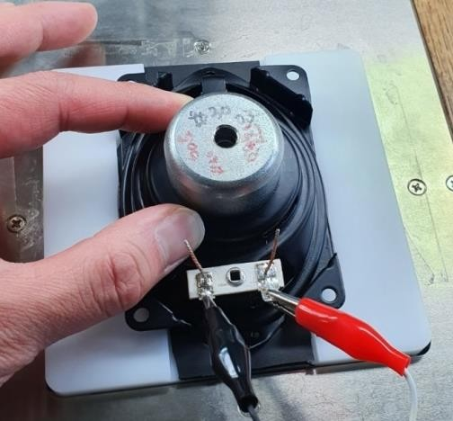
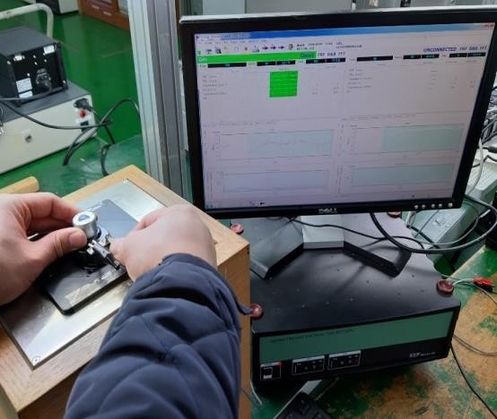
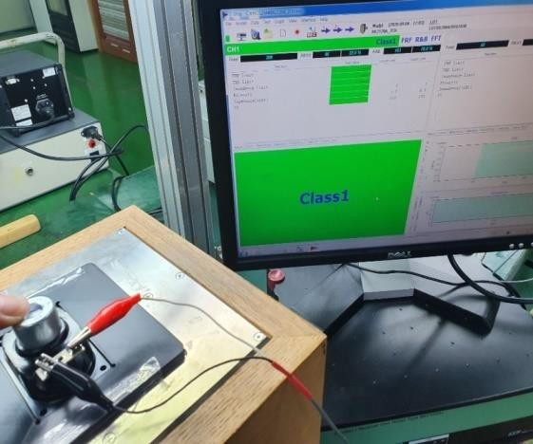
▣ Unit Line Inspector Measurement Guide
※ Measurement
Insert Unit to JIG & connect cable(5sec)
Measurement(10sec)
Judgement

Slide 5
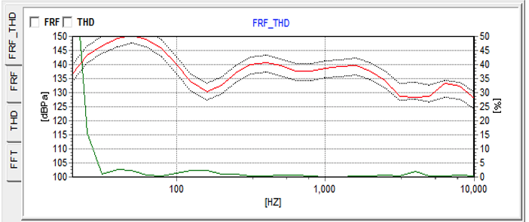
▣ Unit Line Inspector Measurement Guide
※ Frequency Response Criteria
Testing range:
- Woofer: F0 ~ 10KHz
- Full range: F0 ~ 20KHz
Reference graph: Golden sample’s FR graph(provided by supplier)
Pass/Fail Criteria: Within +/- 3dB from reference graph
Testing sweep time: 5sec
Upper Graph: +3dB(Upper limit)
Red Graph: Reference Graph
Lower Graph: - 3dB(Lower limit)

